Slide 1

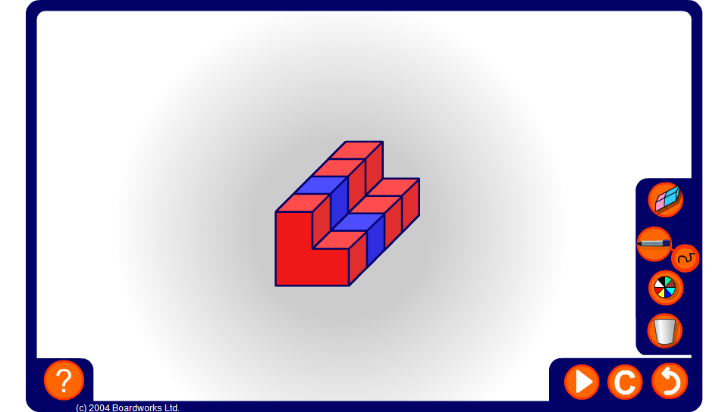


Quarter or not?
Notes:
The aim of this activity is to ensure that pupils are able to identify which shapes have one quarter shaded. For shapes drawn in three dimensions pupils will need to imagine the parts of the shape that are not visible in the two dimensional drawing.

